Slide 1
ME 233 Advanced Control II Lecture 6 Discrete Time Kalman Filter
(ME233 Class Notes pp.KF1-KF6)
TexPoint fonts used in EMF.
Read the TexPoint manual before you delete this box.: AAAAAAAAAA

Slide 2
Course Outline
Finished
Unit 0: Probability
Unit 1: State-space control, estimation
Unit 2: Input/output control
Unit 3: Adaptive control

Slide 3
Wiener Filtering
Norbert Wiener:
Well-known as the founder of cybernetics, a field he developed in the 1970s that emphasized the modeling of humans as communication and control systems.
In 1942 he did significant work in the use of time series for military applications; an example of which would be the prediction of the location of enemy planes at the next time step.
His work in filtering, prediction and smoothing came about in 1949. Wiener filtering is solved for Gaussian time series and under certain assumptions, stationary time series.

Slide 4
Rudy Kalman:
First major contribution was the introduction of the self-tuning regulator in adaptive control.
Between 1959 and 1964 he wrote a series of seminal papers:
First, the new approach to the filtering problem, known today as Kalman Filtering
In the meantime, the all pervasive concept of controllability and its dual, the concept of observability, were formulated.
By combining the filtering and the control ideas, the first systematic theory for control synthesis, known today as the Linear-Quadratic-Gaussian or LQG theory, resulted.

Slide 5
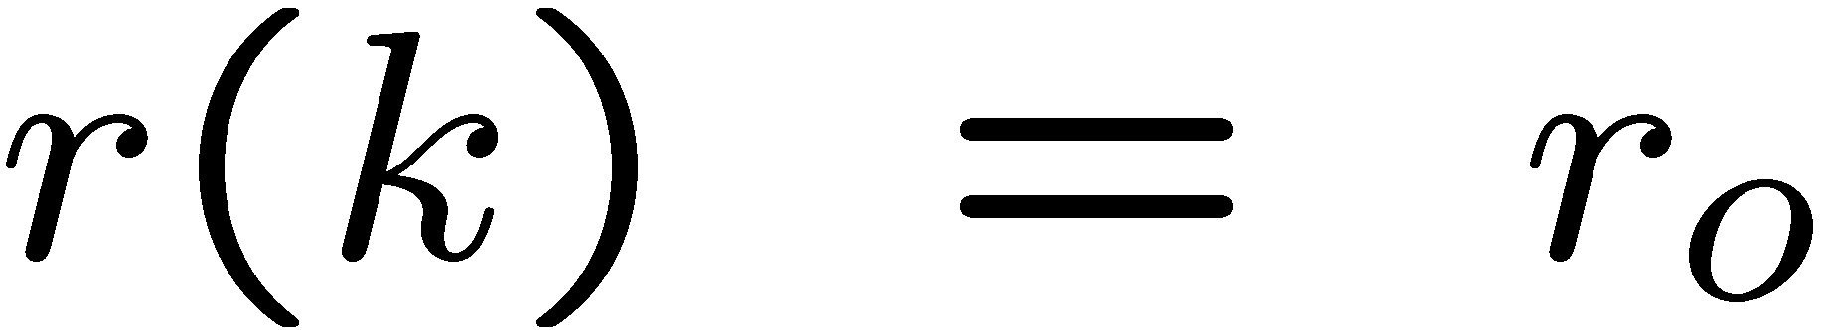

Deterministic - state feedback
State variable feedback:
With fictitious reference input r(k)

Slide 6
Deterministic - state feedback
ME 232 Approach: State Variable Feedback
What happens if the state is not directly measurable – only the output y(k) ?

Slide 7
Deterministic– state estimation
ME 232 Approach: State observer

Slide 8
Deterministic– state observer feedback

Slide 9
Stochastic State Estimation
System is now contaminated by noise
Two random disturbances

Slide 10
Stochastic State Estimation
System is now contaminated by noise
Input noise w(k) - contaminates the state
⇒
x(k) is now a random sequence

Slide 11
Stochastic State Estimation
System is now contaminated by noise
Measurement noise v(k) - contaminates the output y(k)

Slide 12
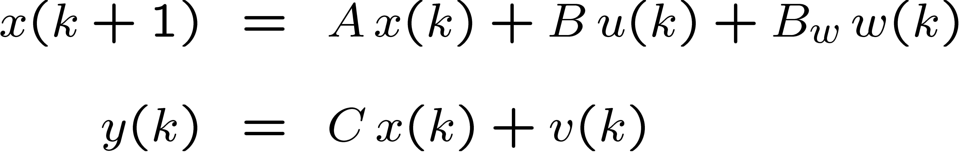
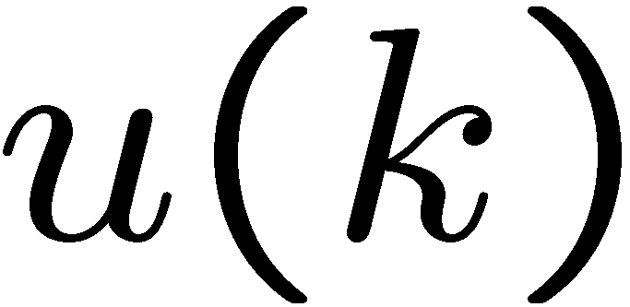
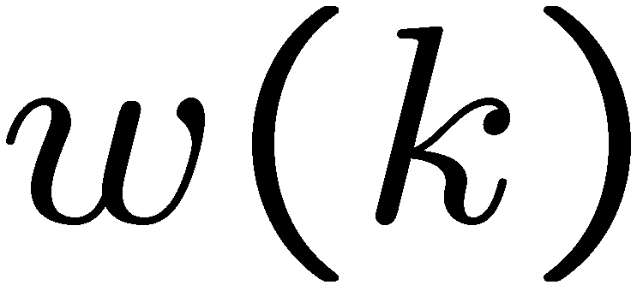
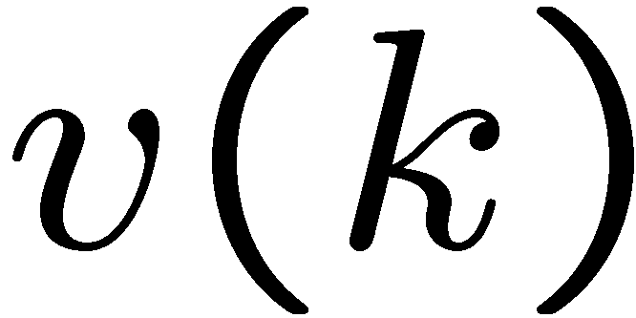
Stochastic state model
Where:
known control input
input noise
measurement noise

Slide 13
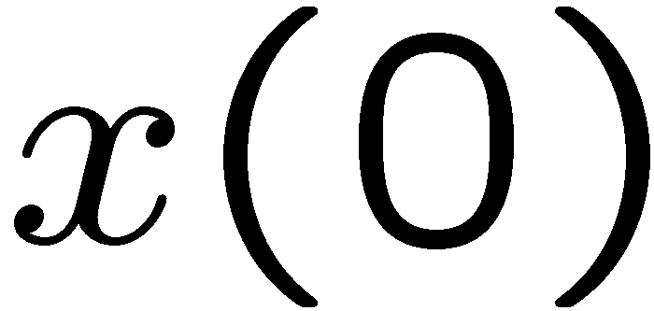
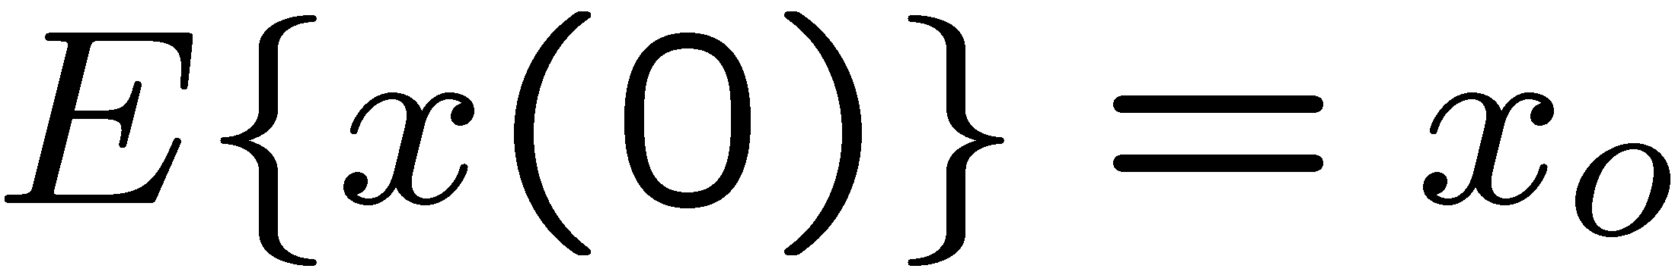
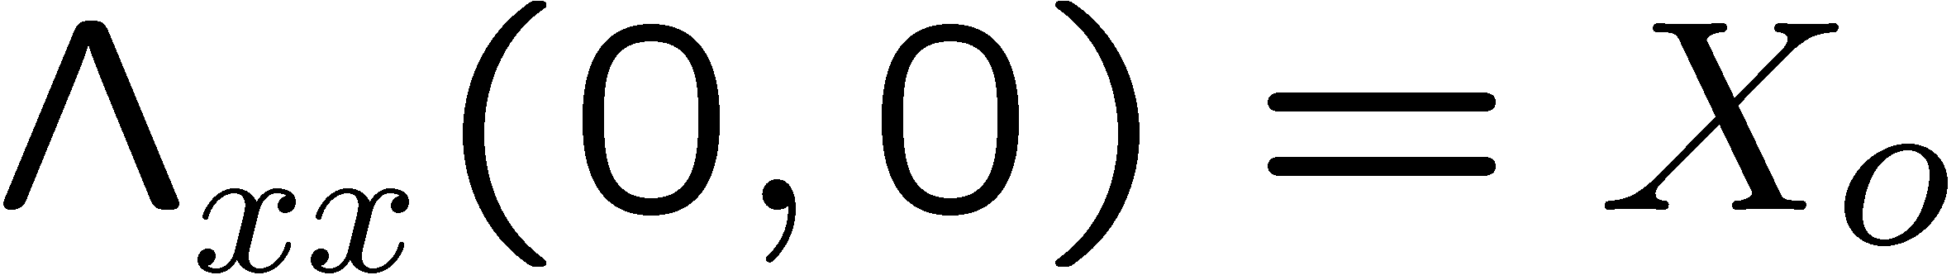
Initial Conditions
is Gaussian with known
marginal mean and covariance:

Slide 14
Noises
and are:
Gaussian zero mean uncorrelated noises
independent from each other and from
Not necessarily stationary

Slide 15
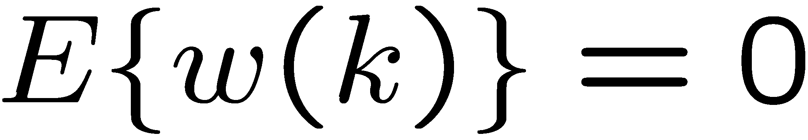
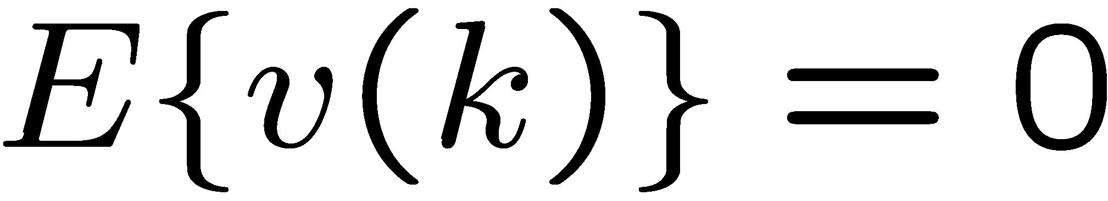
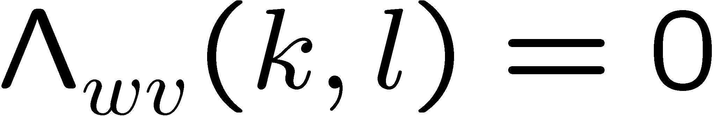
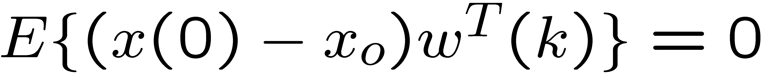

Noises

Slide 16
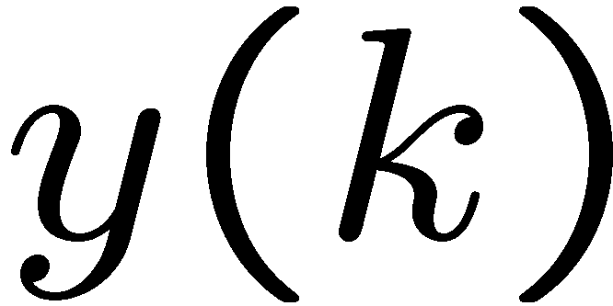
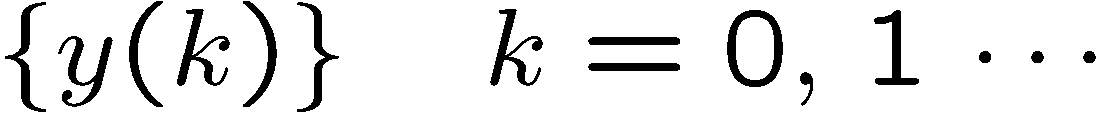
Output Measurements
is the measured output, which is considered as an outcome at instant k of the random sequence
set of available measurements at the instant j

Slide 17
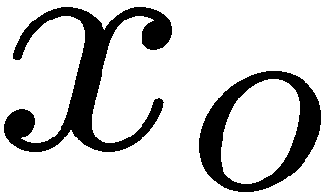
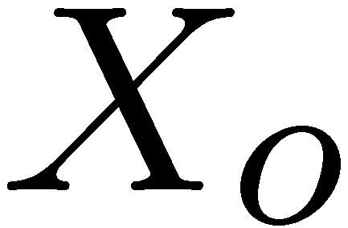
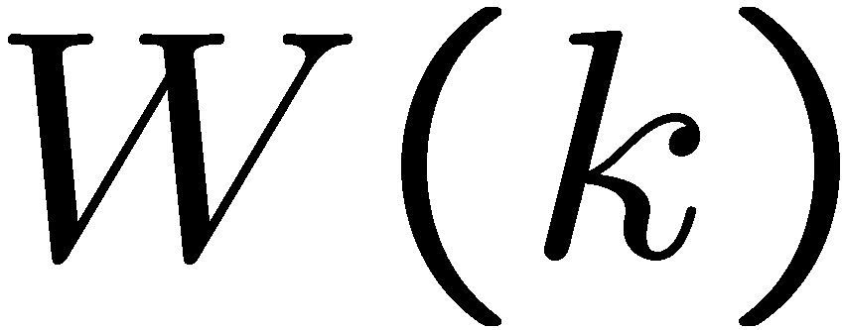
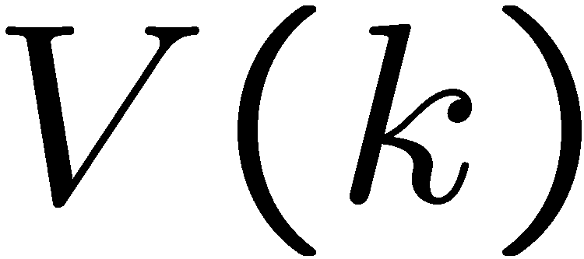
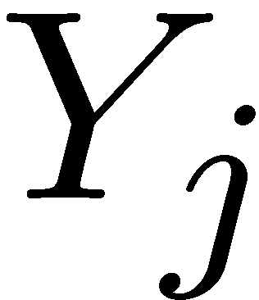
Notation so far …
Initial state marginal mean:
Initial state marginal covariance:
Input noise covariance :
Measurement noise covariance:
Set of j+1 output measurements:

Slide 18
Kalman Filter Objective
Obtain the best state estimate given available measurements
Conditional state estimation problem

Slide 19
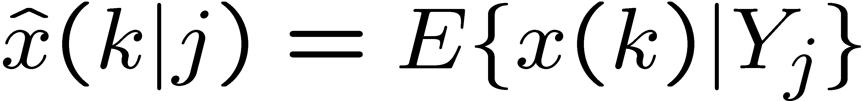
Conditional state estimation
New notation:
Conditional state estimate
given the set of available measurements:

Slide 20
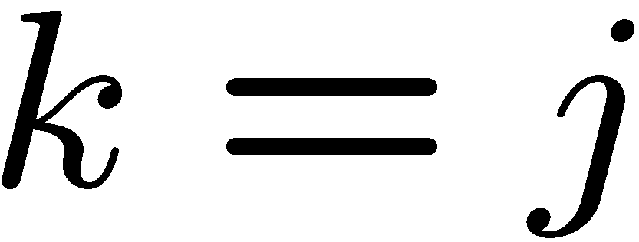
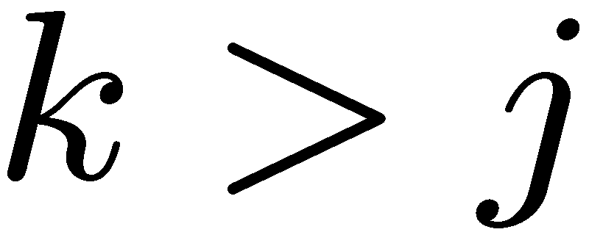
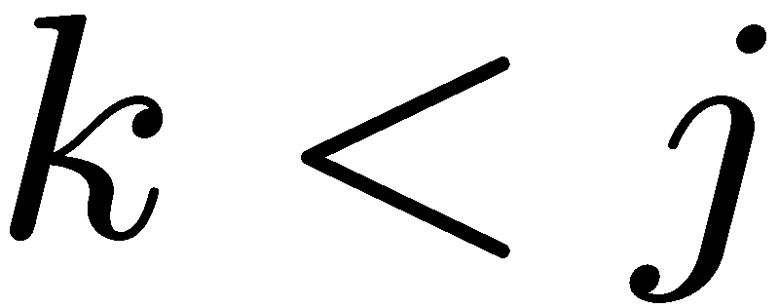
Conditional state estimation
When:
this is a filtering problem
this is a prediction problem
this a smoothing problem
our focus

Slide 21
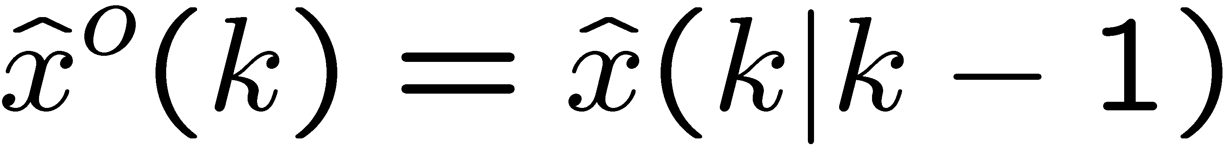
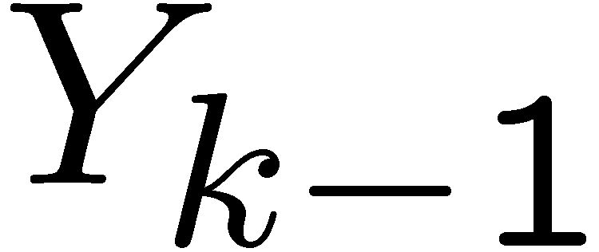
A-priori state estimate (one step prediction)
New notation:
Conditional state estimate
given the set of available measurements:
before y(k)
A-priori state estimation error:

Slide 22
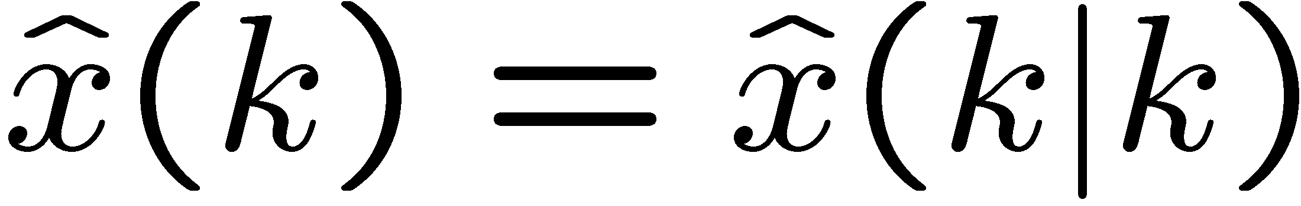
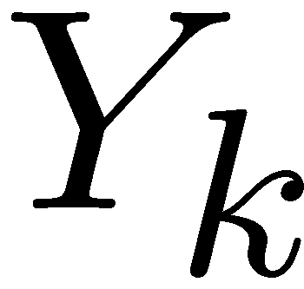
A-posteriori state estimate (filtering)
New notation:
Conditional state estimate
given the set of available measurements:
after y(k)
A-posteriori state estimation error:

Slide 23
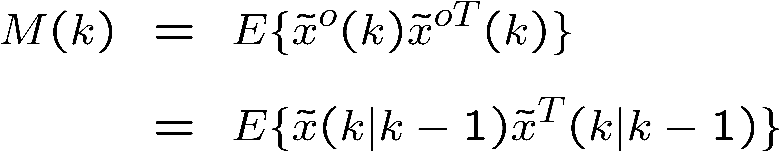
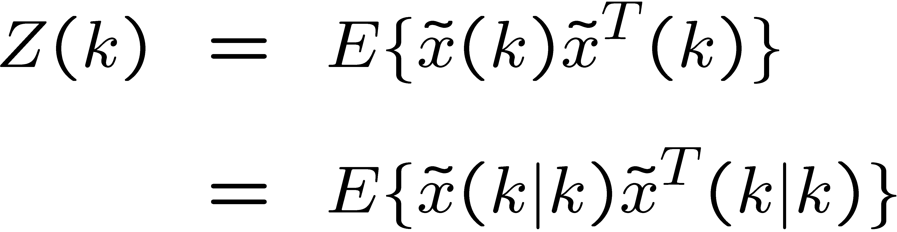
State Estimate Covariances
A-priori estimation error covariance:
A-posteriori estimation error covariance:

Slide 24
Summary of estimate notation
A-priori state estimate :
A-posteriori state estimate :
A-priori output estimate :

Slide 25
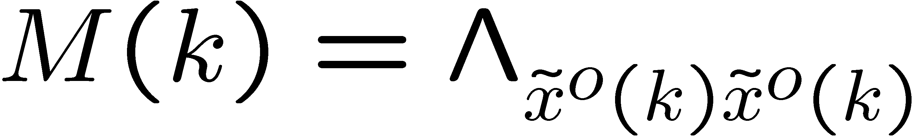
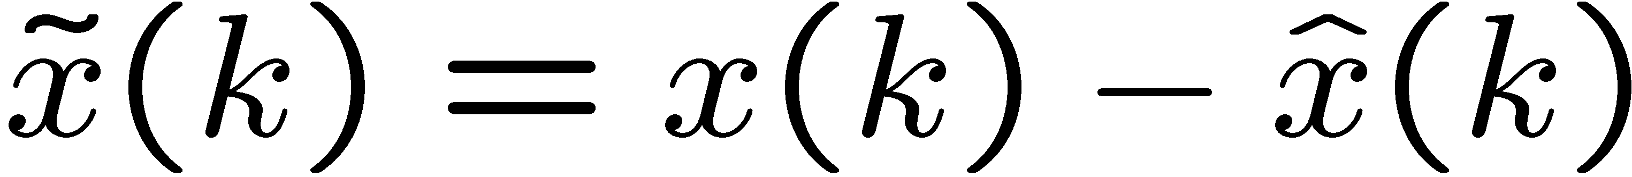
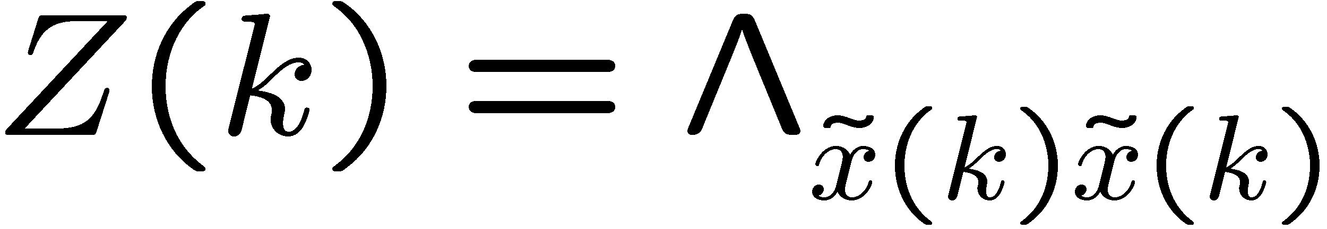
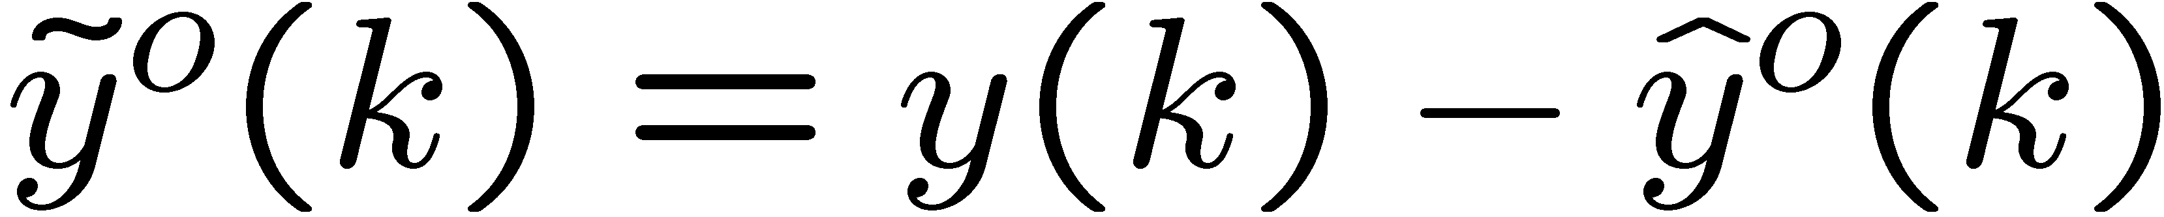
Summary of estimate error notation
A-priori state estimation error and covariance :
A-posteriori state estimation error and covariance:
A-priori output estimation error :

Slide 26
State Estimate Covariances
Notice that:
A-posteriori
A-priori

Slide 27
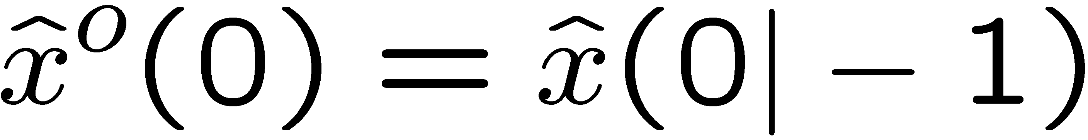
Initial Conditions for a-priori estimate
Notice that:
a-priori state estimate—before measuring y(0)
initial state marginal estimation

Slide 28
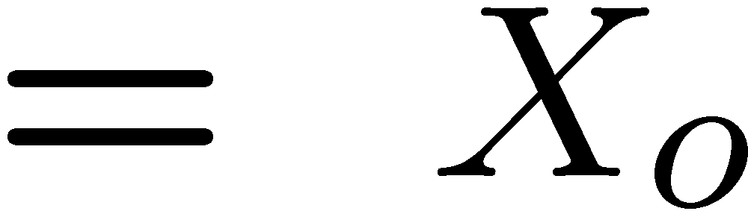
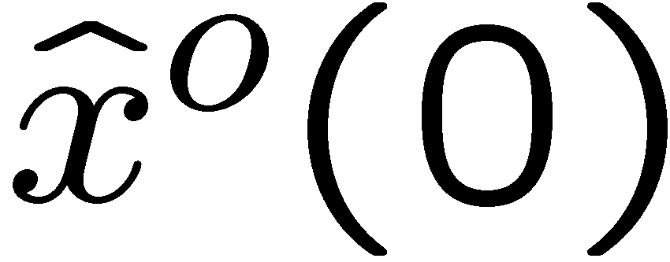
Initial Conditions for a-priori estimate
Notice that:
initial state
marginal covariance

Slide 29
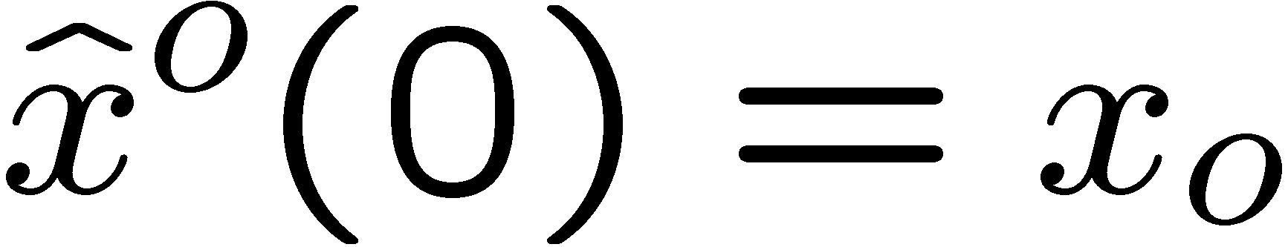
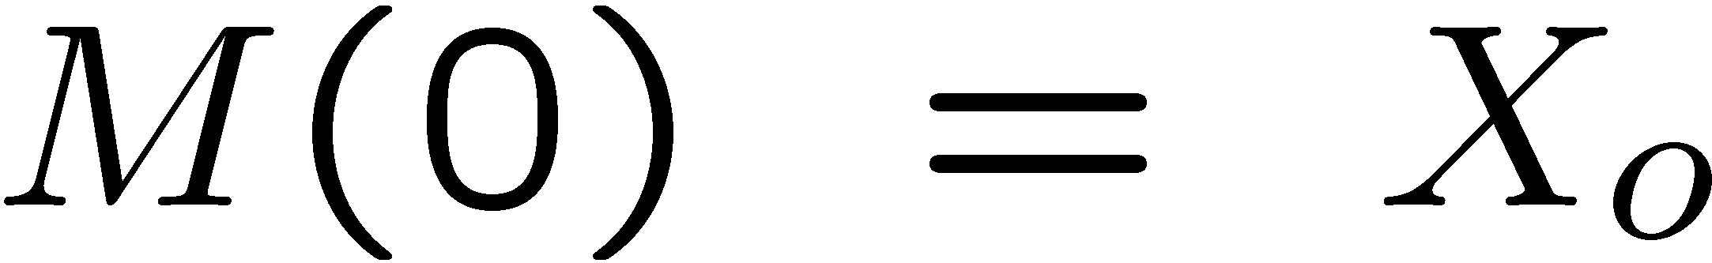
Kalman Filter Solution
Given:
I.C.:
Noise covariance intensities:

Slide 30
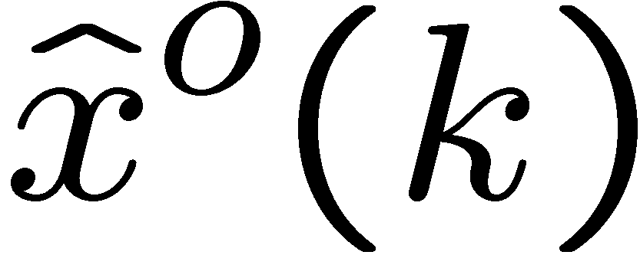
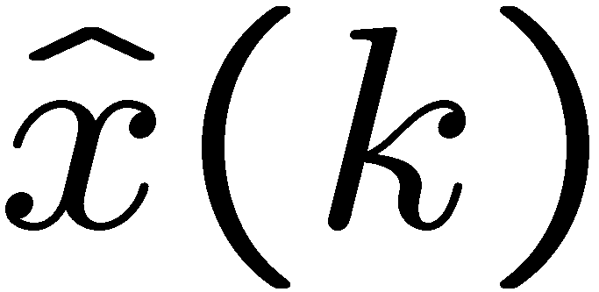
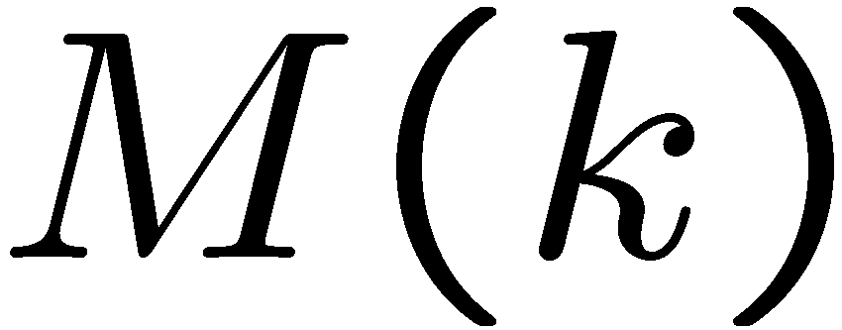
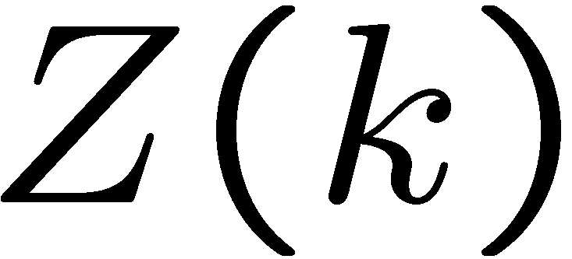
Kalman Filter Solution
Want to recursively find:
State estimates:
Error covariances:
a-priori
a-posteriori

Slide 31
Kalman Filter Solution
Remember:
Conditional state estimates:
a-priori (before y(k) )
a-posteriori (after y(k) )

Slide 32
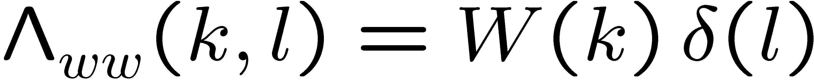
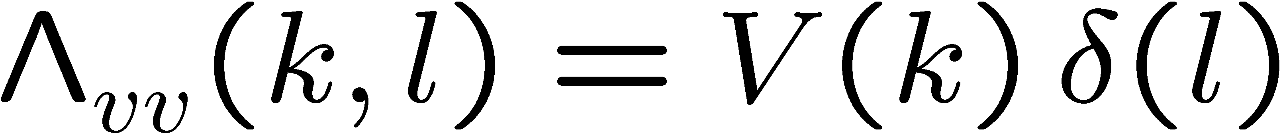
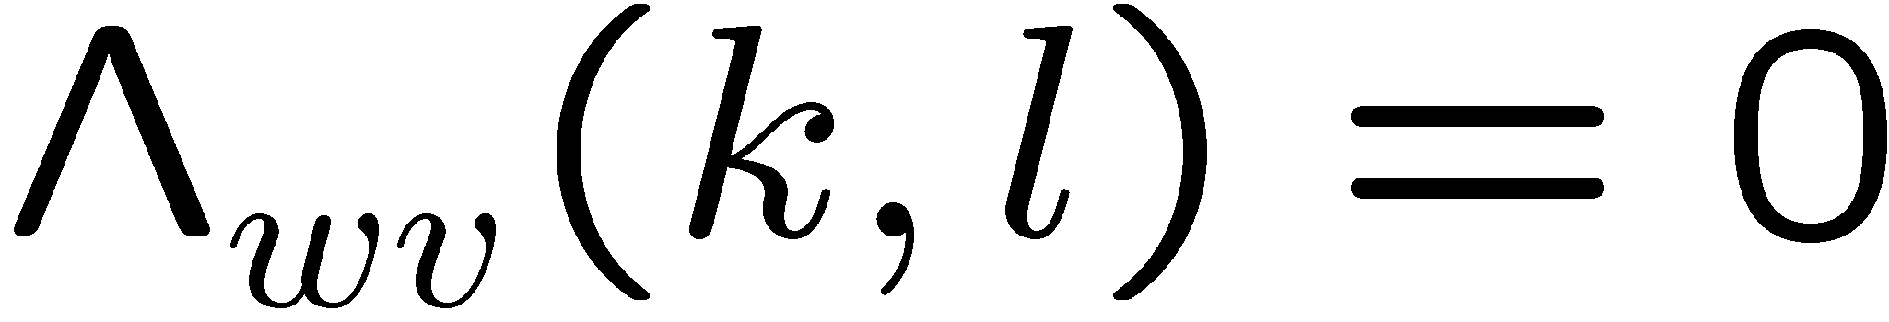
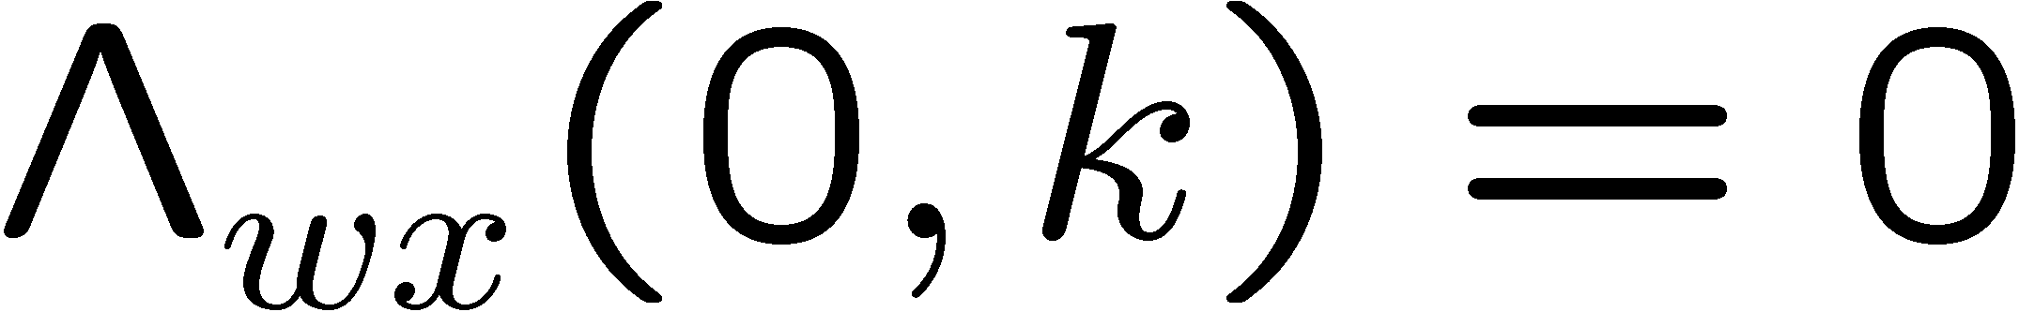
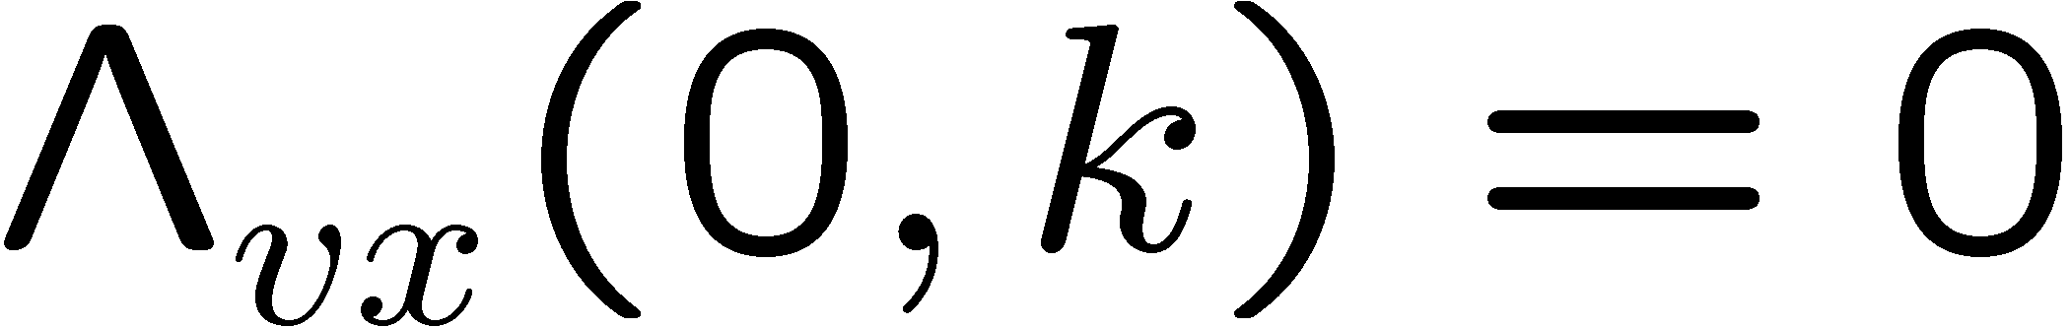
Kalman Filter Solution
Remember:
noises are uncorrelated Gaussian, zero-mean RVSs that are uncorrelated with each other and the initial state:

Slide 33
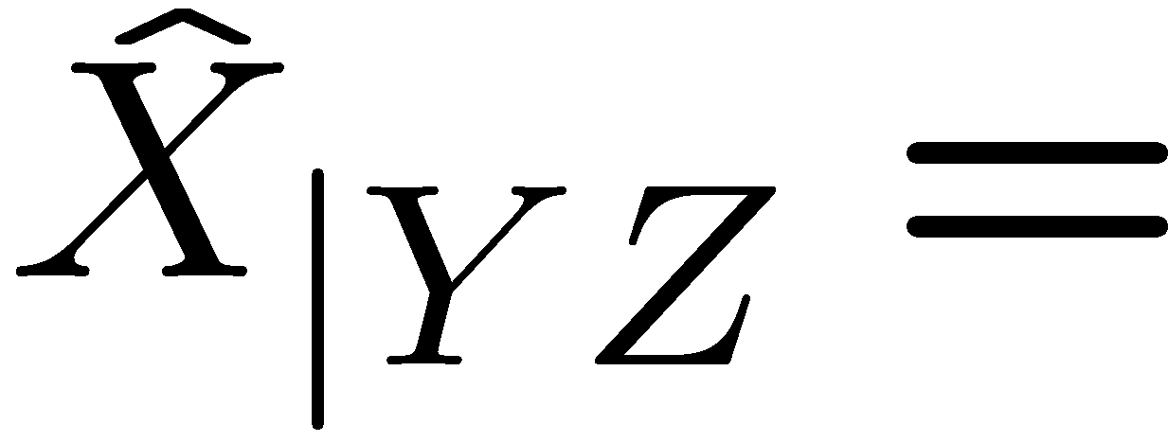
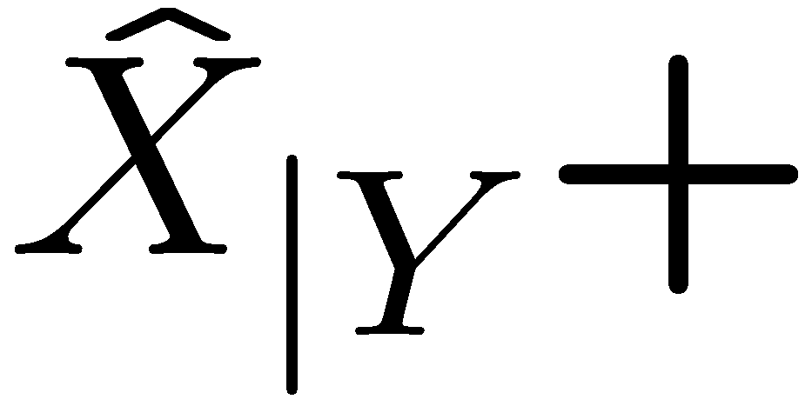
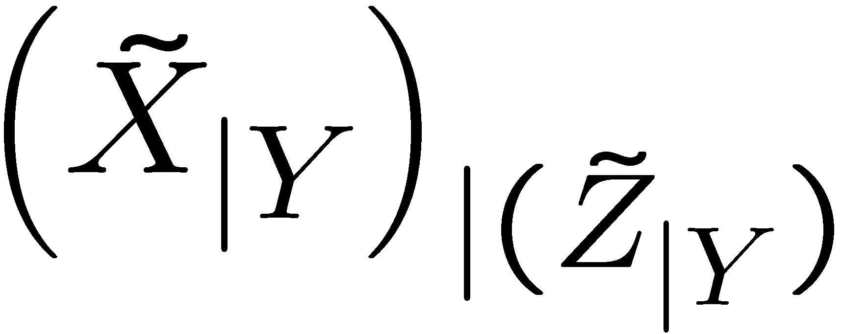





We will use property 3 of least squares estimation
Conditional estimator of X given Y and Z
Previous lecture notation:
Notation for Kalman filter:

Slide 34



We will use property 3 of least squares estimation
Conditional estimator of x(k) given Y_{k-1} and y(k)
Previous lecture notation:
Notation for Kalman filter:

Slide 35
We will use property 3 of least squares estimation
Conditional estimation error of X given Y and Z
Previous lecture notation:
Notation for Kalman filter:

Slide 36
We will use property 3 of least squares estimation
Conditional estimation error of X given Y and Z
Previous lecture notation:
Notation for Kalman filter:

Slide 37


Kalman Filter Solution: k = 0
Before measurement y(0):
(given)
(given)

Slide 38





Kalman Filter Solution: k = 0
A-priori output estimate:
A-priori output estimation error (KF residual)

Slide 39


Kalman Filter Solution: k = 0
Review of the results so far:
a-priori
a-posteriori

Slide 40

Kalman Filter Solution: k = 0
After measurement y(0):
Calculate a-posteriori state estimate using the conditional estimation formula for Gaussians:
(We exploited that )

Slide 41






Calculate:

Slide 42




Calculate:

Slide 43


Kalman Filter Solution: k = 0
a-posteriori state estimate:

Slide 44

Kalman Filter Solution: k = 0
Review of the results so far:
a-priori

Slide 45
Kalman Filter Solution: k = 0
A-posteriori state estimation error:
A-posteriori state estimation error covariance:

Slide 46
Kalman Filter Solution: k = 0
a-posteriori state estimation covariance:
Use least squares result:

Slide 47
Kalman Filter Solution: k = 0
a-posteriori state estimation covariance:
Use least squares result:

Slide 48
Kalman Filter Solution: k = 0
Review of the results so far:

Slide 49


Kalman Filter Solution: k = 1
Before measurement y(1):
Determine a-priori state estimate
Determine a-priori state estimation error covariance

Slide 50
Kalman Filter Solution: k = 1
A-priori state estimate:
Use state equation and take conditional expectations:
Independent
from y(0)

Slide 51
Kalman Filter Solution: k = 1
A-priori state estimation error:
Use state equation:

Slide 52





Kalman Filter Solution: k = 1
A-priori state estimation error covariance:
Use:

Slide 53
Kalman Filter Solution: k = 1
A-priori state estimation error covariance:

Slide 54




Kalman Filter Solution: k = 1
Before measurement y(1):

Slide 55


Kalman Filter Solution: k = 1
Before measurement y(1):
A-priori output estimation error

Slide 56


Kalman Filter Solution: k = 1
Review of the results so far:
a-priori
a-posteriori

Slide 57

Kalman Filter Solution: k = 1
After measurement y(1):
Calculate a-posteriori state estimate using the conditional estimation formula for Gaussians:
(We exploited that )

Slide 58

Kalman Filter Solution: k = 1
Before measurement y(1):
A-priori output estimation error

Slide 59


Kalman Filter Solution: k = 1
IMPORTANT: Property 1 of least squares estimation:
The a-priori output estimation error
is uncorrelated with

Slide 60




Calculate

Slide 61



Kalman Filter Solution
Calculate

Slide 62


Kalman Filter Solution: k = 1
a-posteriori state estimate:

Slide 63
Kalman Filter Solution: k = 1
Review of the results so far:

Slide 64
Kalman Filter Solution: k = 1
A-posteriori state estimation error:
A-posteriori state estimation error covariance:

Slide 65

Kalman Filter Solution: k = 1
a-posteriori state estimation covariance:
Use least squares result:

Slide 66
Kalman Filter Solution: k = 1
Review:
Equations are entirely recursive!

Slide 67
Kalman Filter Solution
Compute a-priori output estimation error residual:
Compute a-posteriori state estimate:
Update a-priori state estimate:

Slide 68
Kalman Filter Solution
4) Compute a-posteriori state estimation error covariance:
5) Update a-priori state estimation error covariance:

Slide 69




Kalman filter implementation

Slide 70
Kalman Filter Solution V-2
Kalman filter algorithm can be written in a different manner, which only involves the a-priori state estimate and the a-priori estimation error covariance.

Slide 71

Kalman Filter Solution V-2
Plug
Into
Results in

Slide 72


Kalman Filter Solution V-2
where

Slide 73

Kalman Filter Solution V-2
Plugging
Into
Results in the following
discrete Riccati difference equation:

Slide 74
Kalman Filter Solution V-2
A-priori state observer structure:

Slide 75




Kalman Filter Solution V-2
Same structure as deterministic a-priori observer

Slide 76
Kalman Filter Solution V-1 (Review)
A-posteriori state observer structure:

Slide 77
Kalman Filter Solution V-1
A-posteriori estimator as output
o
+
-1
+

Slide 78


Kalman Filter, State Space Form

Slide 79

Kalman Filter, State Space Form

Slide 80
Kalman Filter (KF) Properties
The KF is a linear time varying estimator, even when the system is LTI and the noises are WSS
The KF is the optimal state estimator when the input and measurement noises are Gaussian.
The KF is still the optimal linear state estimator even when the input and measurement noises are not Gaussian.

Slide 81

Kalman Filter (KF) Properties
The KF a-priori output error (a-priori output residual)
is often called the innovation
it contains only the “new information” in y(k)
Moreover,
i.e. is an uncorrelated RVS

Slide 82




Kalman Filter (KF) Properties
Proof:
It suffices to show that
By causality,
By least squares property 1,

Slide 83




KF as an innovations filter
We will assume, without loss of generality that the control input is zero, i.e.
Plant:
Kalman filter V-2:

Slide 84



KF as an innovations filter
plant
Kalman filter
Uncorrelated
noise input
Uncorrelated
noise output
Correlated
noise output

